Slide 1
CS310 Operating Systems Lecture 34 : File System - 2
Ravi Mittal
IIT Goa

Slide 2
Acknowledgements !
Contents of this class presentation has been taken from various sources. Thanks are due to the original content creators:
Book: Modern Operating Systems by Andrew Tanenbaum and Herbert Bos,
Chapter 4
Book: Linux System Programming: talking directly to the kernel and C library, by Robert Love
Book: Computer Systems, A programming Perspective, Bryant and O’Hallaron
Class presentation: University of California, Berkeley, CS162
Book: Linux – The Textbook, by Sarwar, Koretsky

Slide 3
Read the following:
Book: Modern Operating Systems, by Andrew Tanenbaum and Herbert Bos
Chapter 4
Book: Linux System Programming: talking directly to the kernel and C library, by Robert Love
Book: Operating Systems: Three Easy Pieces, Remzi H. Arpaci-Dusseau and Andrea C. Arpaci-Dusseau

Slide 4
Today’s Class
File System – Introduction (previous class)
Directories
Hard and Soft (Symbolic) links - Concepts

Slide 5
Previous Classes

Slide 6
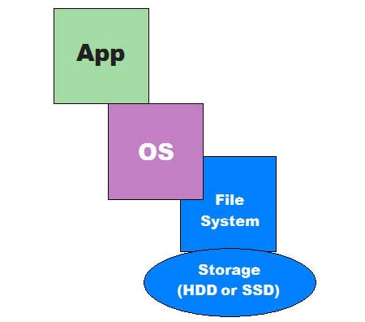
File System
Files are logical unit of information – Created by Processes
A Disk may contain thousands of files – usually independent of each other
Processes can read existing files and create new files
Files remain in existence not affected by process creation and termination
File must disappear only when the owner explicitly deletes it
File are managed by Operating system
File System deals with how files are
Structured
Named
Accessed
Used
Protected
Implemented, and
Managed
Adapted from: Tanenbaum, Modern Operating Systems

Slide 7
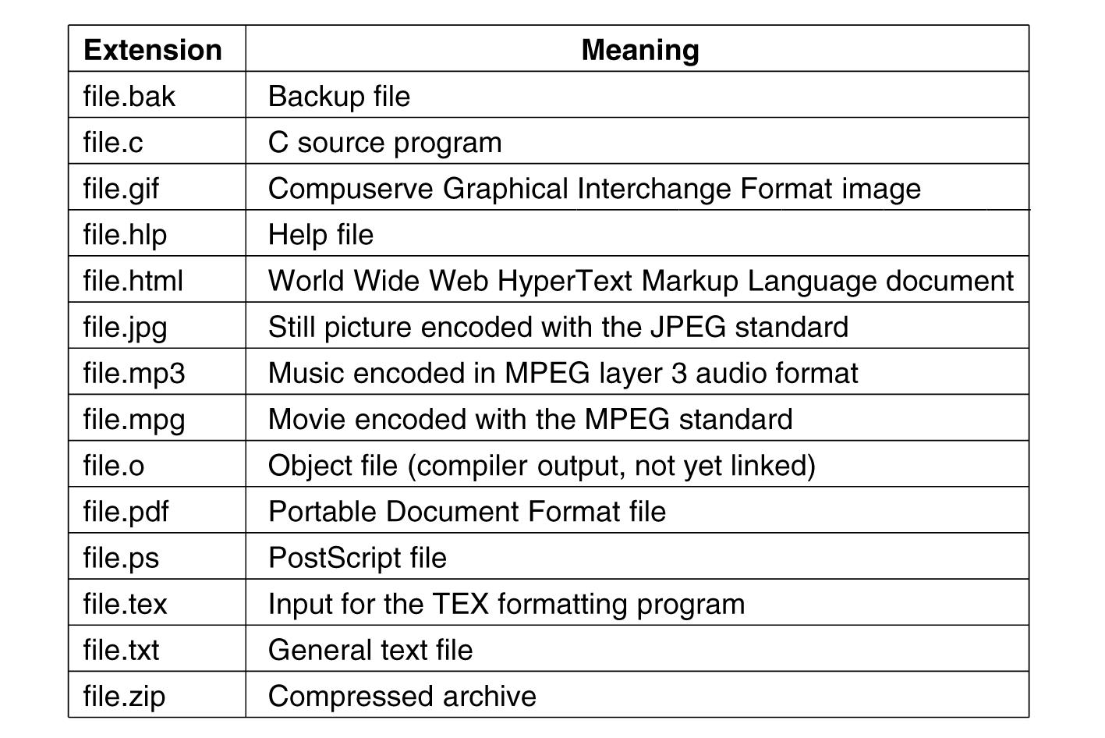
File Naming
Adapted from: Tanenbaum, Modern Operating Systems

Slide 8
File Structure – Three categories
Byte sequences
Maximum flexibility-can put anything in
Unix and Windows use this approach
Byte stream
Fixed length records (card images in the old days)
Read/Write operations are done on one record
Example: Based on Punch cards (80 columns) – record 80 characters
Not in use
VMS OS provides highly structured file – with records
Tree of records- uses key field to find records in the tree
Tree is sorted on the key field
Used in some large mainframes
In use
Obsolete
Obsolete
Adapted from: Tanenbaum, Modern Operating Systems

Slide 9
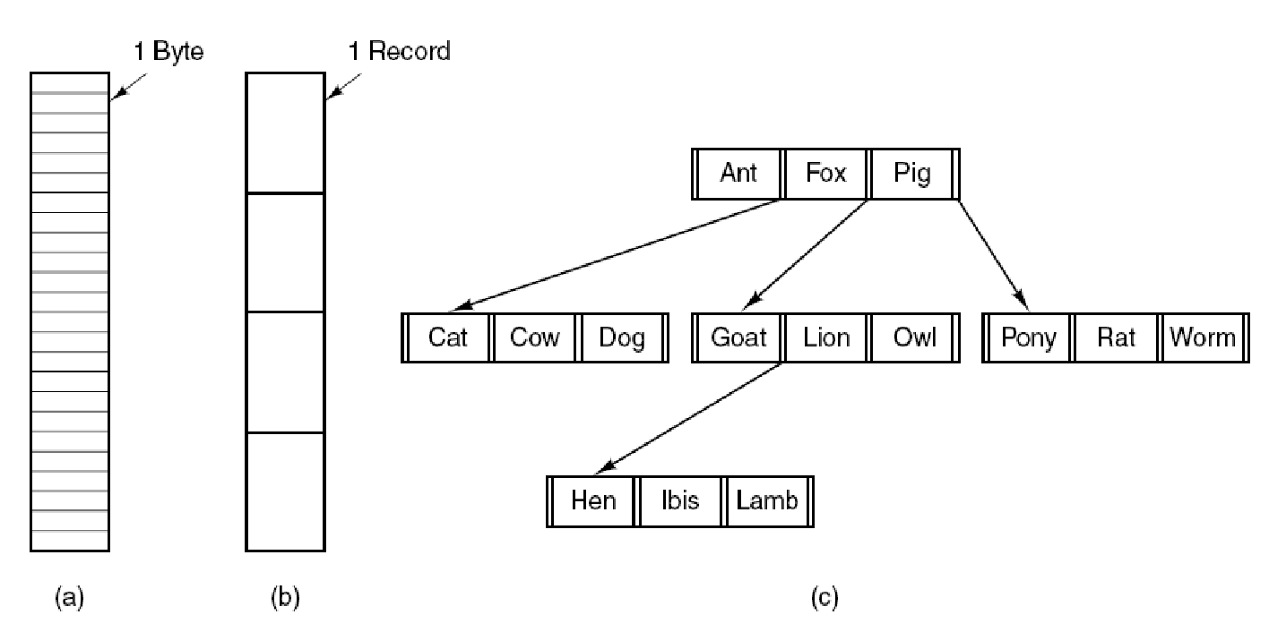
File Structure – Three Types
Bye
sequence
Record
sequence
Tree
Adapted from: Tanenbaum, Modern Operating Systems

Slide 10
File Types
Regular Files (most common)
Text
Binary
Directories
A file that contains the names and locations of other files
Character Special and Block Special Files
Terminals (character special) and disks (block special)
FIFO (named pipe)
A file type used for inter-process communication
Socket
A file type used for network communication between processes
Adapted from: Tanenbaum, Modern Operating Systems

Slide 11
Regular Files
What we mostly call as files – are regular files
Regular files contain bytes of data organized into linear array called a byte stream
Linux has no further organization or formatting specified for a file
Any byte within a file can be read or written to
Read or write operation start at a specific byte
Conceptual location
File position or file offset
Essential metadata
At file opening – file position is zero
Adapted from: Linux System Programming : Robert Love

Slide 12
Regular Files (Linux)
File reading or writing is done byte by byte
The file position increases
File position may be set manually
File position starts at zero
Writing a byte to the middle of a file overwrites over the previous byte
It is not possible to expand a file by writing into middle of it
Adapted from: Linux System Programming : Robert Love

Slide 13
Regular Files (Linux)
A single file may be opened more than once
By the same process or different processes
Each open instance of a file gives a unique file descriptor
Processes can share their file descriptors
No restriction on concurrent file accesses by multiple processes
If concurrent reading and writing is happening
Result may be unpredictable
So user processes must coordinate
Files are associated with file names but they are referenced by inode – information node
Inode is assigned an integer value unique to the file system – inode number or i-number
Adapted from: Linux System Programming : Robert Love

Slide 14
Regular Files (Linux) - inode
When a file is created
System allocates a unique inode to the file
It creates an entry in the directory in which the file is created
Directory entry: an ordered pair (inode number, filename)
The inode number for a file is used to access its attributes, including its contents on the disk for reading or writing (changing) them
An Inode stores metadata associated with a file
Modification time stamp / access time
Owner (UID, GID)
Type (file, directory, device, pipe, …)
Length
Pointers to data blocks that store file’s contents
Example: You created a file Chapter 3 in your current working directory
System allocates inode number 53472
Directory entry: (52473, Chapter3)

Slide 15
Inode diagram
inode
File info
Direct blocks
Indirect blocks
Double
Indirect
Blocks

Slide 16
Directories

Slide 17
Directories - Introduction
Directories are handled as normal files
However, marked in inode as directory
Accessing a file via its inode number is cumbersome and unsecure (security hole)
Files are always opened from user space by a name
Not by inode number
Directories are used to provide the names with which to access files
A directory provides mapping of human-readable names to inode numbers
A name and inode pair is called a link
Directory is implemented as a simple table or a hash
Implemented and managed by Kernel
The kernel directly uses this mapping to perform name-to-inode resolutions

Slide 18
Directories - Introduction
A user application requests a file name to be opened
Kernel opens the directory containing the filename and searches for the given name
From the filename, the kernel obtains the inode number
Inode number points to inode
The inode contains metadata associated with the file and location of file’s data on the disk
Initially, there is only one directory on the disk, the root directory
Donated by /.
There are many directories in a file system
Links inside of directories can point to the inodes of other directories
Directories nest inside of other directories – hierarchy of directories

Slide 19
Directories - Introduction
Users identify files via pathnames example (/home/blackbeard/concorde.png )
To open a given path, kernel walks each directory entry (dentry) in the pathname to find the inode of the next entry
dentry cache in Linux
to store the results of directory resolutions
Path
String that identifies a file or directory
Example: /home/tom/Work/Class/OS/hw1.txt or /home/tom
Absolute Path
if it stats with “/”, the root directory
Example: /bin/ls
Relative Path
relative to a process’s current working directory
Example: Work/Class/OS if the current directly is /home/tom
Equivalent to absolute path: /home/tom/Work/Class/OS

Slide 20
Directories - Introduction
Paths are resolved from left to right and the respective name is looked up in the directory
As long as the current name is not the last in the path, it has to be a directory
Else it terminates with an error

Slide 21
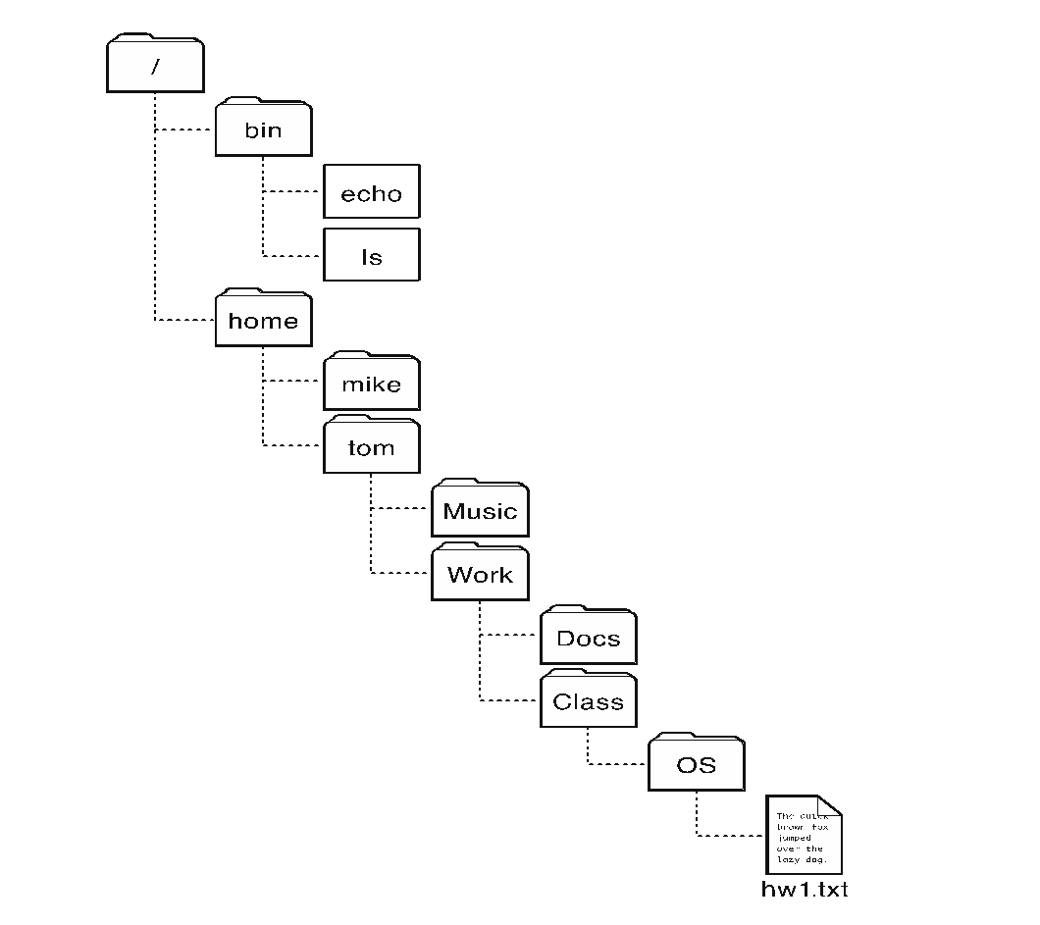
Hierarchical organization of files using directories
Operating Systems Principles and Practice: Anderson and Dahlin

Slide 22
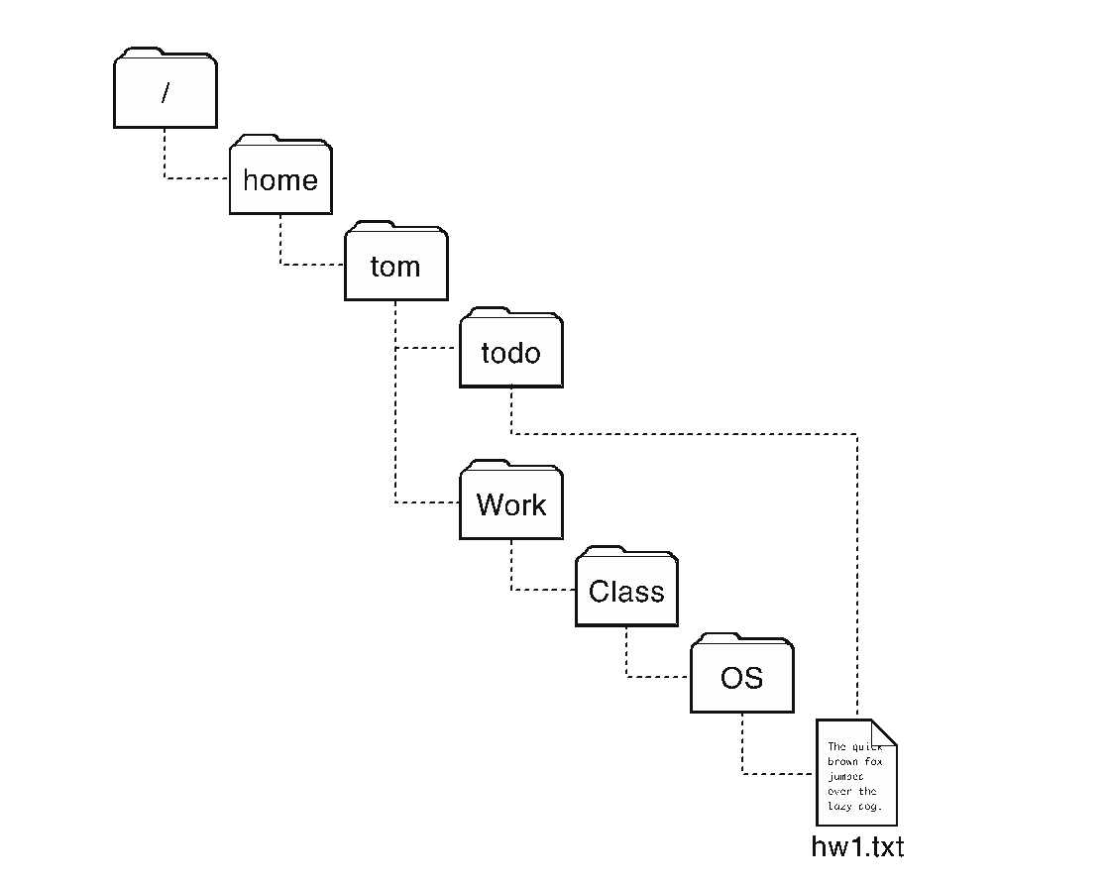
Directory is (not always) a tree
Sometimes it is convenient for a file to appear in two directories
Operating Systems Principles and Practice: Anderson and Dahlin

Slide 23
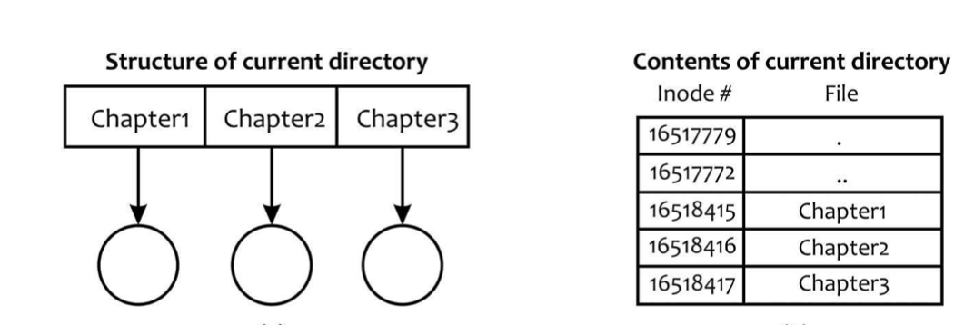
Directory Structure
Consider a current directory containing three files: Chapter 1, Chapter 2, and Chapter 3
Files
Logical Structure
Contents of the disk block
containing current directory
Adapted from: Linux: The Textbook by Sarwar and koretsky

Slide 24
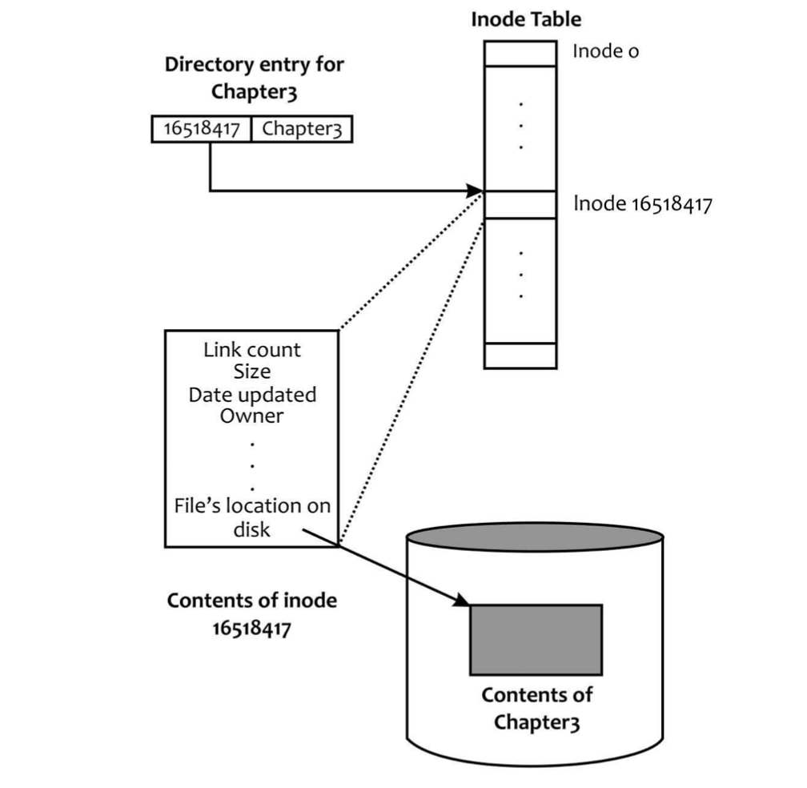
Directory Entry, inode, and file contents
Adapted from: Linux: The Textbook by Sarwar and koretsky

Slide 25
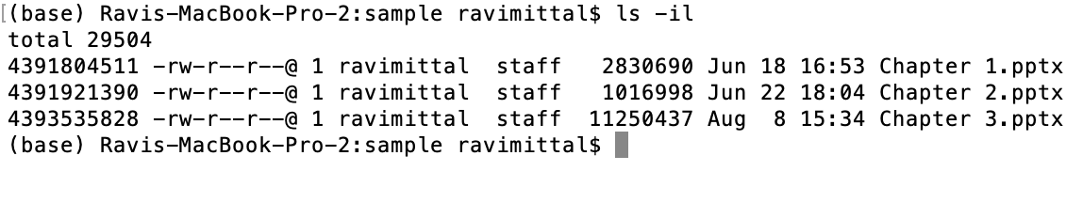
ls –il command

Slide 26
Hard and Soft (Symbolic) Links

Slide 27
File Sharing Via links
Attributes of a Linux file are stored in its inode on disk
When a file is opened, its inode is copied into the main memory
Speedy access to its contents
How the use of an inode that results in a mechanism that allows you to access a file by using multiple pathnames?
To allow access to some files and directories through various other directories
A link is a way to establish connection between
Files to be shared with directory enteries
A file has N links, we mean that the file has N directory entries somewhere in the file system hierarchy
Linux supports two types of links:
Hard links
Soft/symbolic links

Slide 28
Hard Links
A hard link is a pointer to the inode of a file
A hard link gives additional file name
All hard links point to the same inode
As long as the link counter is not 0, the file survives
Hard links can be created for files in the same logical file system

Slide 29
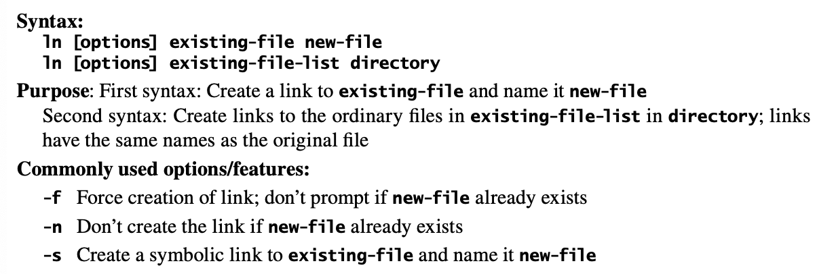
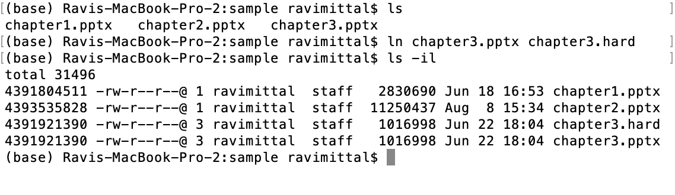
ln command

Slide 30
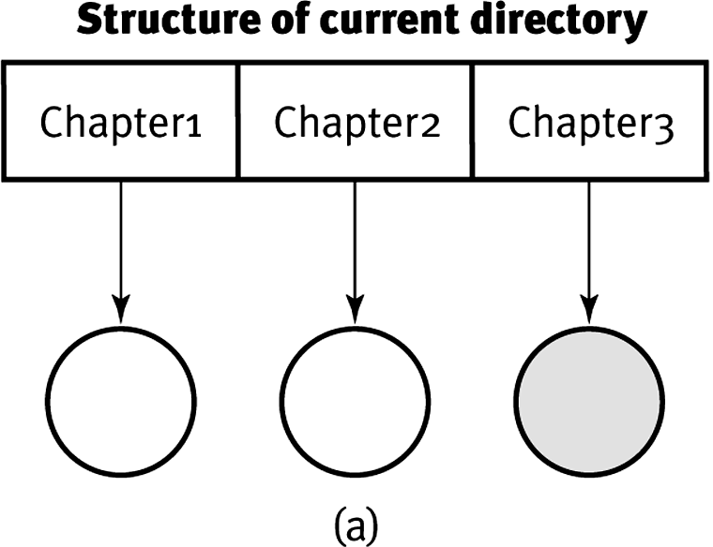
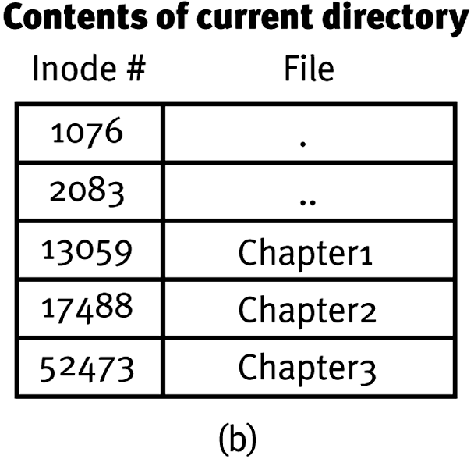
Adapted from: Linux: The Textbook by Sarwar and koretsky

Slide 31
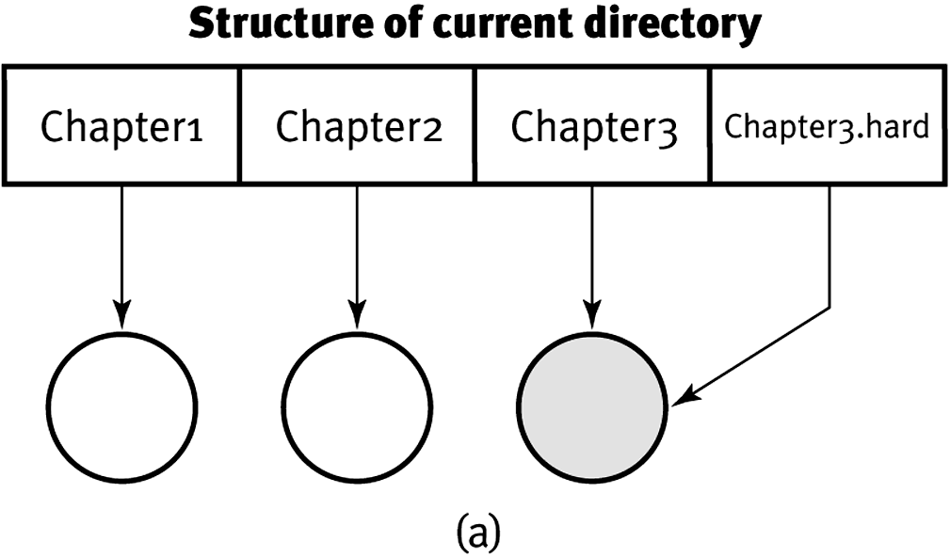
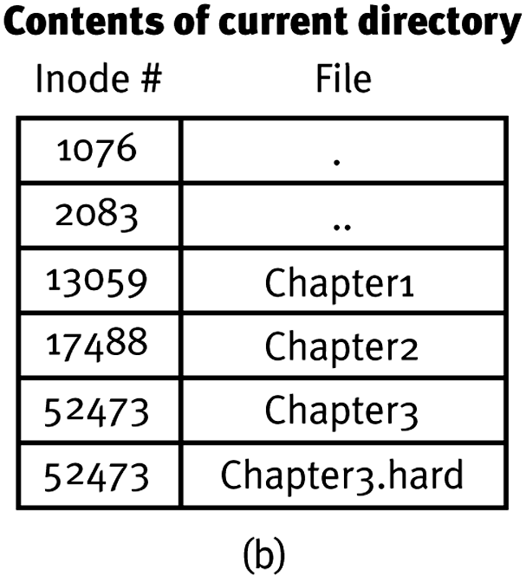
Establishing a hard link Chapter3 Chapter3.hard
Adapted from: Linux: The Textbook by Sarwar and koretsky

Slide 32
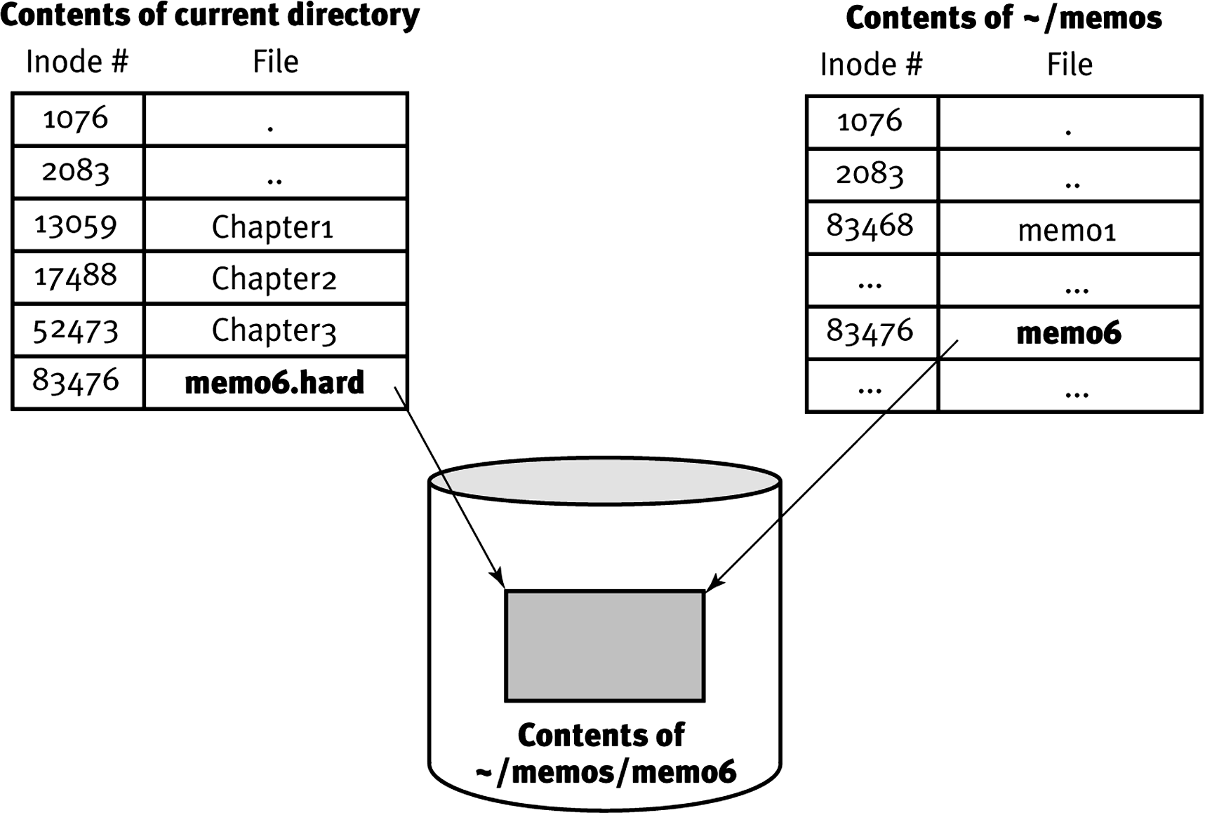
Hard Link across directories ln memo6.hard memos/memo6
Adapted from: Linux: The Textbook by Sarwar and koretsky

Slide 33
Soft link or Symbolic link
Many systems allows to use multiple names to refer to the same file
A symbolic link is a directory mappings from a file name to another file name
To open a file is opened via a symbolic link
File system first translates the name in the symbolic link to the target name and then uses the target name to open the file
Example:
Create /a/b
Create a symbolic link from /c/d/ to /a/b
Unlinking /a/b, the file is no longer accessible and open(“/c/d”) will fail
A MacOS file alias is similar to a symbolic link

Slide 34
Lecture Summary
When a file is created
System allocates a unique inode to the file
Inode stores metadata of the file on disk
Directory stores file name and inode number
Hard and Soft (Symbolic) links provide a way to access a file using multiple pathnames

